Slide 1

PrEP and STIs: the imperative to act now
Connie Celum MD MPH
Departments of Global Health and Medicine
University of Washington

Slide 2
Overview
Is PrEP associated with increases in STIs?
PrEP is uncovering the hidden epidemic of STIs in some populations
Priorities for addressing STIs in PrEP delivery programs

Slide 3
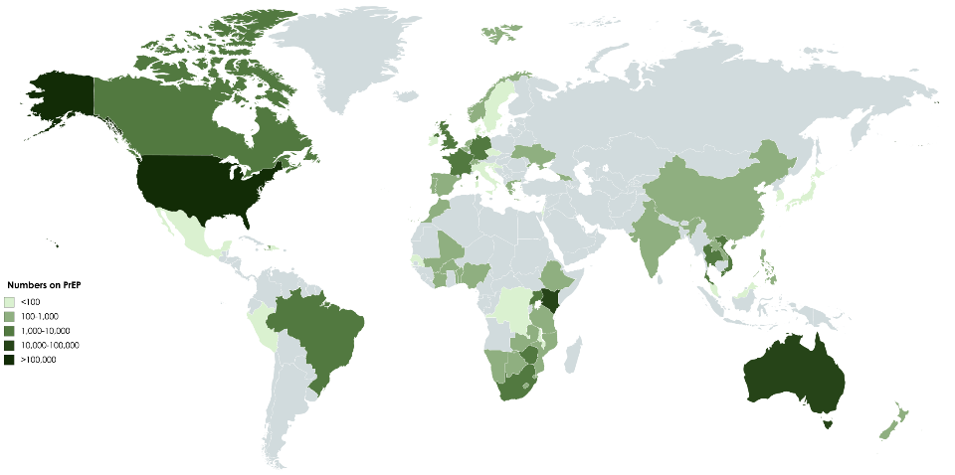
Oral PrEP Global Roll-out in 2018
40 countries with Truvada approved for PrEP
We have come a long ways but we have a very long way to go
1,100
225,000
700
Est. numbers on PrEP:
<100
1,500
100 - 1,000
14,600
1,000 – 10,000
10,000 – 100,000
>100,000
Data from AVAC.org 2018 - https://www.prepwatch.org/country-updates/

Slide 4
STIs occur in persons using PrEP
PROUD Study, UK
N=544
STIs in the 12 months prior to enrollment
  But the population who needs PrEP has high STI rates – and STI rates have been rising in countries prior to PrEP (McCormack et al. Lancet 2016)

Slide 5
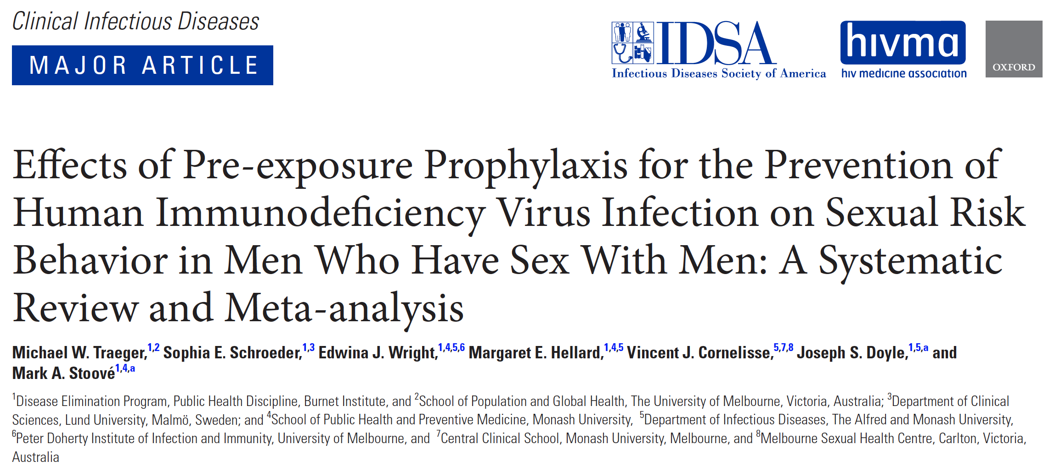
Does PrEP increase STIs?
Traeger et al 2018: Systematic review and meta-analysis of 16 observational and 1 open label studies
  8 studies of STI prevalence (n=4388)
  13 studies condom use (n=5008)

Slide 6
Effect of PrEP on STIs
Effect of PrEP on STIs
Rates of bacterial STIs increasing over time; however, rises pre-date PrEP use
Higher risk in more recent studies: post-2016, OR 1.45 (95% CI1.05-2.05)
No significant increase in proportion reporting condomless sex
Heterogeneity in results, some trend towards increased condomless receptive anal sex with ≥10 partners, with an HIV-positive or HIV-unknown partner, and never using condoms during anal sex
Traeger et al, CID 2018

Slide 7
Conclusions – risk compensation
There is limited evidence of risk compensation
Absence of evidence is not evidence of absence
Is reduced condom use an unintended consequence of PrEP?
NO!
  Many people prefer sex without condoms
  We have an alternative preventive technology to reduce the fear of HIV – it is entirely consequential!
We need to strengthen our STI control programmes

Slide 8
Overview
Is PrEP associated with increases in STIs?
  Concurrent increases in STIs;
  Some but inconsistent evidence of risk compensation
  Implications for STI control programs
PrEP is uncovering the hidden epidemic of STIs in some populations
Priorities for addressing STIs in PrEP delivery programs

Slide 9
STI incidence in DISCOVER trial
TAF/FTC and TDF/FTC for PrEP
Objective: To assess HIV incidence in MSM and TGW who have sex with men and who are administered daily TAF/FTC or TDF/FTC
Primary Endpoint:
Seroconversion rate/100 p-y
Week 0
48
72
96
n=2500
FTC/TAF (200/25 mg) QD
F/TAF
FTC/TDF (200/300 mg) QD
Switch option
n=2500
Gonorrhea incidence ~45% per year
Chlamydia at 42% per year
Syphilis at 10% per year
Extraordinarily high rates and comparable between the two arms
Hare, CROI 2019, abstract 104LB

Slide 10
STIs in MSM in Australian PrEPX study
48% of 2981 MSM diagnosed with STIs over 1 year of follow-up
25% accounted for 76% of all STIs
Younger age, more partners, & group sex associated with STIs
40% increase in STIs after starting PrEP; 12% increase after adjusting for testing frequency
Traeger JAMA 2019

Slide 11
STIs in young African women in HIV prevention studies: Chlamydia prevalence
 | CT prevalence
VOICE (South Africa, Uganda, Zimbabwe) N=5029 | 12%
MTN-020/ASPIRE (Malawi, So Africa, Uganda, Zimbabwe) N=2629 | 12%
Plus Pills (Cape Town) N=150 | 48%
HPTN 082 (Cape Town, Johannesburg, Harare) N=427 | 29%
POWER (Cape Town, Johannesburg, Kisumu) N=1504 | 26%
3P project (Cape Town) N=200 | 25%
ECHO (eSwatini,Kenya, South Africa, & Zambia) N=7829 | 18%
90-98% of women were asymptomatic in studies that assessed symptoms

Slide 12
STIs in young African women in HIV prevention studies: Chlamydia incidence
 | CT prevalence | CT incidence
VOICE (South Africa, Uganda, Zimbabwe) N=5029 | 12% | 27%
MTN-020/ASPIRE (Malawi, So Africa, Uganda, Zimbabwe) N=2629 | 12% | 27%
Plus Pills (Cape Town) N=150 | 48% | NA
HPTN 082 (Cape Town, Johannesburg, Harare) N=427 | 29% | 33%
POWER (Cape Town, Johannesburg, Kisumu) N=1504 | 26% | 53%
3P project (Cape Town) N=200 | 25% | 42%
ECHO (eSwatini,Kenya, South Africa, & Zambia) N=7829 | 18% | NA
Most incident CT infections were in different women than prevalent CT
High incidence not treatment failure; indicates high CT prevalence in male SP

Slide 13
GC prevalence and incidence in young African women in HIV prevention studies
 | GC prevalence | GC incidence
VOICE (South Africa, Uganda, Zimbabwe) N=5029 | 4% | 11%
MTN-020/ASPIRE (Malawi, So Africa, Uganda, Zimbabwe) N=2629 | 4% | 11%
Plus Pills (Cape Town) N=150 | 6% | NA
HPTN 082 (Cape Town, Johannesburg, Harare) N=427 | 8% | 11%
POWER (Cape Town, Johannesburg, Kisumu) N=1504 | 10% | 20%
3P project (Cape Town) N=200 | 11% | 14%
ECHO (eSwatini,Kenya, South Africa, & Zambia) N=7829 | 5% | NA
<1% syphilis and 6-8% trichomonas

Slide 14

Learning about incident STI infections in young southern African women using PrEP
Most incident STIs were new infections
  79 (66%) of 119 chlamydial infections
  41 (85%) of 48 GC infections
  23 (79%) of 29 trichomonas infections
Not likely failure of STI treatment or partner notification
Few characteristics distinguished participants with an STI from those without an STI during follow-up
  High prevalence and incidence without strong predictors makes targeted screening a challenge
Delany-Moretlwe, ISSTDR 2019, Tues O10.3
STI incidence was 29.6 per 100 person-years (py) for CT (95% CI 24.3, 35.4), 11.8 per 100 py for GC (95% CI 8.7, 15.7), and 7.1 per 100 py for TV (95% CI 4.7, 10.2).
The majority of incident STIs were new infections: 79 /119 (66%) CT infections, 41/48 (85%) GC infections, and 23/29 (79%) TV infections diagnosed were in women who did not have these infections at enrollment.
Predictor | Comparison | Crude odds ratio (OR) | Adjusted OR | 95% CI | P-values
Age |  | 0.96 | 0.98 | 0.9-1.06 | 0.531
Site | Emavundleni CRS vs. Ward 21 |  | 1.52 | 0.92-2.54 | 0.101
Site | Spilhaus CRS vs. Ward 21 |  | 1.16 | 0.68-1.94 | 0.591
STI status at baseline (GC/CT/TV vs. None) | Yes vs. No | 1.94 | 1.88 | 1.24-2.84 | 0.003
In the past year has your current or most recent partner punched slapped kicked bit you or caused you any type of physical harm | Yes/prefer not to answer vs. No | 1.66 | 1.7 | 1.08-2.66 | 0.020
Any anal sex past month | Yes/prefer not to answer vs. No | 0.62 | 0.60 | 0.4-0.9 | 0.015

Slide 15
STIs and HIV incidence in ECHO trial
N= 7830
 | DMPA |  |  | Copper IUD |  |  | LNG implant
 | N | N events | Rate | N | N events | Rate | N | N events | Rate
Chlamydia or GC
Both negative | 2030 | 104 | 3.8 | 2022 | 97 | 3.5 | 2046 | 76 | 2.7
Either/both positive | 519 | 39 | 5.7 | 548 | 41 | 5.6 | 537 | 39 | 5.4
Almost 2 fold higher HIV incidence in ECHO with women who had CT and GC
Much talk but little progress in integration of FP, STI, and HIV prevention services
PrEP provides an opportunity to actualize this long overdue integration
ECHO consortium, Lancet 2019, supplement table 8

Slide 16
STIs in subSaharan Africa: STIMA
Meta-analysis of 18 HIV prevention studies from 1993-2011, representing >37,000 women
Higher prevalence for all STIs (other than HSV-2) in 15-24 year old women compared to 25-49 year old
CT prevalence: South Africa 15% & East Africa 10%
GC prevalence: South Africa 5% & East Africa 2%
Syphilis concentrated in high risk women
High prevalence of HSV-2 (70-83%) and BV (33-43%)
Torrone, PLoS Med 2018

Slide 17
Status of STI services in Africa
Very high prevalence of CT, GC, trich, and BV in young women ages 16-22
Sequelae of GC and CT understudied & underappreciated
  PID, infertility, ectopic pregnancy, chronic pelvic pain
  Stigma & increased HIV risk related to infertility
Syndromic management for vaginal discharge has very poor sensitivity (23%) and specificity (85%)
  Diagnostic accuracy of 50%; very poor for accurate management of cervical infections
Limited evaluation of STD symptoms, only syphilis and HIV testing in public clinics, ANC, HIV and PrEP programs
  Integration of FP & HIV has been challenging; integration of PrEP with sexual reproductive health may be easier
Barnabas Int J STD and AIDS 2018

Slide 18
Overview
Is PrEP associated with increases in STIs?
PrEP is uncovering the hidden epidemic of STIs in some populations
  Alarmingly high rates of STIs in African AGYW & MSM in many settings
  Failure of syndromic STI management
  Need to strengthen STI control efforts
Priorities for addressing STIs in PrEP delivery programs

Slide 19
Priority 1
Improve & move beyond syndromic STI management
  Why is syndromic management still the standard of care?
    Limited investment in STI programs in low & middle income countries
    Cost of STI testing & lab systems
    Belief that symptomatic STIs are most important
      Yet, asymptomatic STIs increase inflammation and HIV risk
We have known the limitations of syndromic management for vaginal discharge syndrome 2 decades
  Very poor sensitivity & specificity in women
  Contributes to antibiotic resistance
  False sense of security in providers and patients, given low sensitivity and specificity
  Masson STI 2019
  Hoffman STD 2019
  Torrone PLoS Med 2018
  Kulartne PLoS One 2018
  Kaida BMC ID 2018

Slide 20
Priority 1a: Integrate point of care STI tests and revise WHO syndromic algorithms for women
Risk screening for GC, CT and syphilis in Rwandan women
  Pregnant, transactional sex past year, new SP past 3 months, clinical signs
Diagnostic testing based on risk score and symptoms
  GC/CT (GenXpert), Trich (OSOM), syphilis (Determine) & vaginal pH (5.5 cutoff)
POC integration is feasible and improves case-finding and management
Higher sensitivity and specificity of WISH compared to WHO algorithms
  WISH algorithm for CT & GC: 75% sensitivity & 100% specificity
  WHO algorithm for CT & GC: 61% sensitivity & 45% specificity
Verwijs, Lancet ID 2019

Slide 21
Priority 1b:
Make sensitive STI diagnostic tests affordable
Negotiate volume guarantee and costs for GC and CT NAAT tests
  GenXpert machines are already in many countries
  ‘Near patient’, not quite POC (results in 90 minutes)
  Precedence with HIV self-test kits that negotiated volume reduced costs substantially
  Need CEA of downstream benefits of infections detected, treated, and adverse outcomes averted

Slide 22
Needs for diagnostic STI tests
WHO REASSURED criteria
  Real time connectivity
  Ease of specimen collection
  Affordable, accurate, accessibility, architecture
  Sensitive
  Specific
  User-friendly & simple
  Rapid & robust
  Equipment free
  Delivered to end users
Only HIV, syphilis and TV tests meet ASSURED criteria
Need WHO and donor (PEPFAR, Global Fund, UNITAID) volume guarantee & price negotiations for GC and CT NAAT
Toskin STI 2017
Toskin BMJ 2017
Unemo Lancet ID 2017
Peeling Lancet ID 2019

Slide 23
Priority 2
Integrate PrEP with reproductive health services
PrEP is not a stand alone service; meeting reproductive health needs could increase PrEP uptake and persistence
What is the ‘minimum PrEP package’? How to do it simply and cost-effectively?
  Minimum package for all attending PrEP service
  HIV testing (national algorithm)
  Syndromic STI diagnosis and Rx
  TB screening
  PEP
  Pregnancy test
  Contraception
  Counselling (screen for mental health, alcohol/substance use/mental health
  Condoms
  Additional minimum package for those choosing PrEP
  Creatinine (future plans to review frequency)
  Adherence support – peer support
  Other services to link to as needed
  Laboratory STI diagnosis
  Hep B screening & vaccination
  Pregnancy test - links for ANC and abortion services
  Mental health services
  IPV/GBV service
  Alcohols/substance use services
  CxCa screening and Rx
  VMMC
  PrEP screening tool/questions
  Demand creation
  Prevention/ PrEP awareness
  HIVST to inc prevention and PrEP info
  NDoH web tool for info and service sites
Slide adapted from Rachel Baggaley, WHO

Slide 24
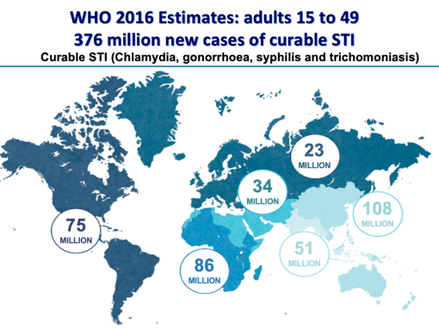


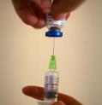
STI services are key part of PrEP delivery
STI testing in PrEP programs meets young women’s and key populations’ needs, values & preferences
Increasing investment in PrEP programs could benefit STI control
  Earlier diagnosis & treatment (quarterly visits for refills)
  Appropriate STI treatment will reduce antimicrobial resistance
  Could leverage lower STI test costs
  Opportunity for POC diagnostics

Slide 25
STI service models in PrEP programs
PrEP services with Rapid or POCT for STI
  UK – Dean St Express
PrEP integrated into STI services
  UK, Australia
  Multi-site Ct/Ng screening
PrEP services with minimal STI screening
  Japan, Brazil, Thailand
  Syphilis only
    Often no CT/NG screening due to costs
PrEP services with syndromic management +/- presumptive treatment
  South Africa, Kenya
PrEP services with referral to another clinic sites STI services
  Thailand (some sites)
PrEP services with no STI service

Slide 26
Addressing STIs within PrEP programmes
WHO 2019

Slide 27
Priority 3: Expedited partner treatment
Feasible, acceptable & underutilized
Durban clinic used GenXpert POC testing for CT,GC, and TV with results in 2 hrs
Expedited partner treatment kit
267 women, median age of 23
18% CT, 5% GC, 3% TV
Of 63 women with STI, 87% accepted EPT kit & 89% reported partner was treated
Focus group discussions: improved communication with SP, who appreciated not having to take time off work/travel to clinic, no IPV reported
Garrett PLoS One 2018

Slide 28
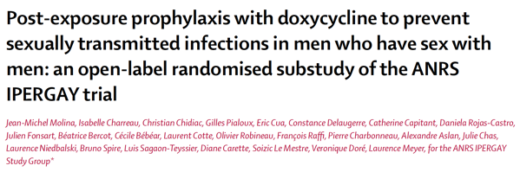
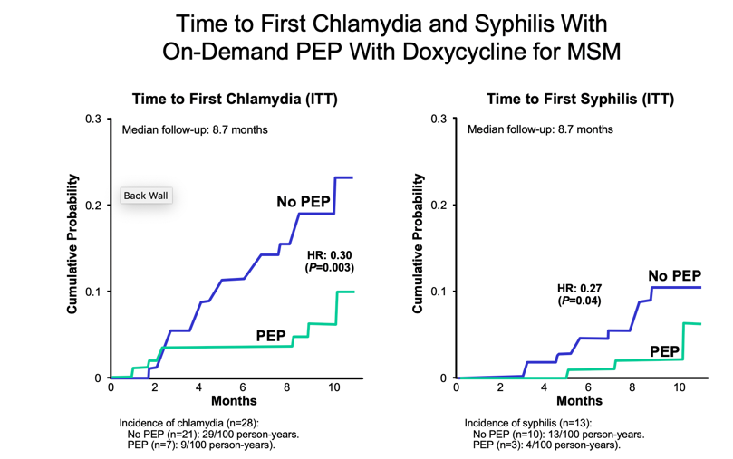
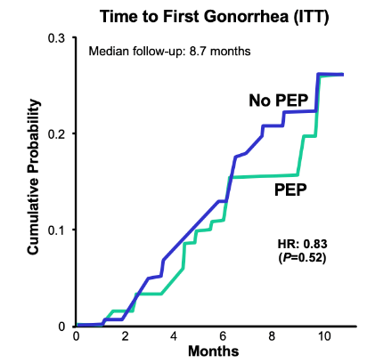
Priority 4
Evaluate innovative STI interventions
On Demand PEP Doxycycline 200 mg
(~24 hours after sex, up to 72 hours)
Lancet ID 2018;18:308-17
No PEP
Randomization
1:1
Visits: baseline and every 2 months
Serologic assays for HIV and syphilis
PCR assays for chlamydia and gonorrhea
Urine, anal, and throat samples collected
Incidence of gonorrhea (n=47):
No PEP (n=25): 35/100 person-years.
PEP (n=22): 29/100 person-years).
Notes:
Slide:
Reference
Molina J-M, Charreau I, Chidiac C, et al. On demand post exposure prophylaxis with doxycycline for MSM enrolled in a PrEP trial. Program and abstracts from the 24th Conference on Retroviruses and Opportunistic Infection; February 13-16, 2017; Seattle, WA. Abstract 91LB.

Slide 29
Equipoise to study doxy PEP for syphilis & CT
Pros
Cons
Limited data; duration?
Costs
Side effects of doxycycline
  Esophagitis/ulceration
  Photosensitivity
Risk compensation?
Reproductive concerns (women)?
Antibiotic resistance
Microbiome effects
Effective in early work
Relatively safe drug
  Chronic use in acne vulgaris
Easy to administer
Few other options for prevention
Considerable interest among some MSM surveyed, with use already reported (Spinelli 2018)
Next steps
      Doxy PEP & PrEP studies in MSM in US, Australia & France
      Doxy PEP in Kenyan women

Slide 30
Priority 5: Invest in STI vaccines
Need interventions to reduce incident GC, given growing cephalosporin and multi-class resistance
Meningococcal B vaccine: 31% reduction in incident GC in New Zealand
  This outer membrane component is part of the 4CMenB vaccine, BEXSERO (GSK)
Model simulations predict that a 40% reduction in prevalence is achievable with a gonococcal vaccine of only 20% efficacy if immunity does not wane
Warrants additional prospective evaluation in high GC incidence populations
Petousis-Harris Lancet 2017
Whelan Emerg Infect Dis 2016;
Petousis-Harris, International Pathogenic Neisseria Conf 2016
Craig A, et al Vaccine 2015

Slide 31
Conclusion:
Time is now; action is imperative
STDs have been neglected in many countries
  ART, ANC, & VMMC programs rarely test for STIs
Many missed opportunities to improve reproductive health and help women recognize their risk of STIs and infertility, as well as HIV
  STIs associated with adverse pregnancy outcomes
  Infertility due to STIs may increase condomless sex and HIV exposure
These issues are not going away
  Improve syndromic management & increase use of sensitive STI diagnostic tests
  Real opportunity for HIV, FP and STI programs to work together

Slide 32
Acknowledgements
Jared Baeten
Rachel Baggely
Linda-Gail Bekker
Elizabeth Bukusi
Sinead Delany-Moretlwe
Jason Ong
Helen Ward
Theodora Wi
PrEP implementers and users
USAID, BMGF, and NIH for funding

